Slide 1
Ph.D Annual Review
Ying Yu

Slide 2
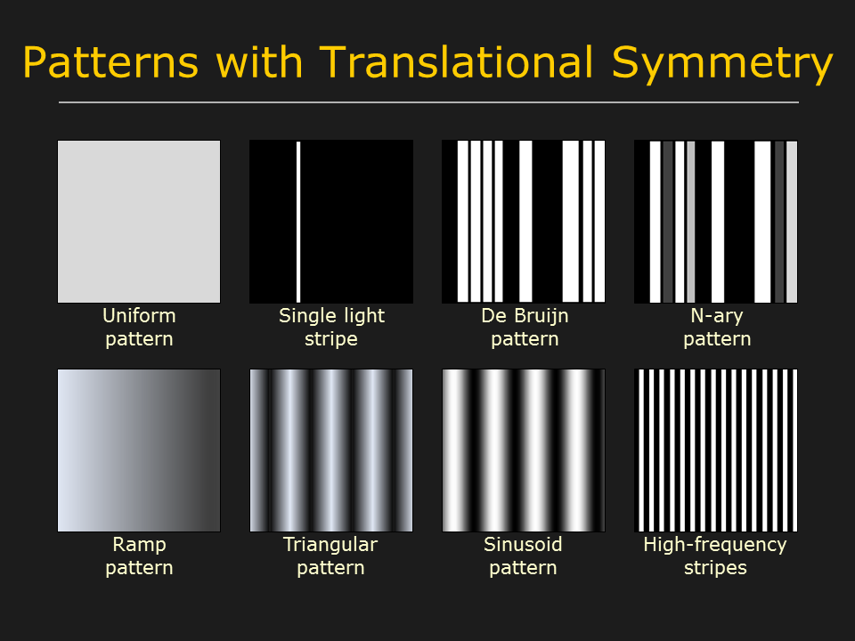

A system incorporates image patterns generated by both hardware and software
Hardware: structured light patterns (grey scale horizontal or vertical bars, usually generated by FPGA)

Slide 3

A system incorporates image patterns generated by both hardware and software
Software: any kinds of patterns that designed on an ordinary PC

Slide 4
Difficulties in implementation
PC-graphics card-monitor system is not real time, unknown timing of the start of each frame. However we have to know the exact timing of PC output videos in order to synchronize with the camera

Slide 5
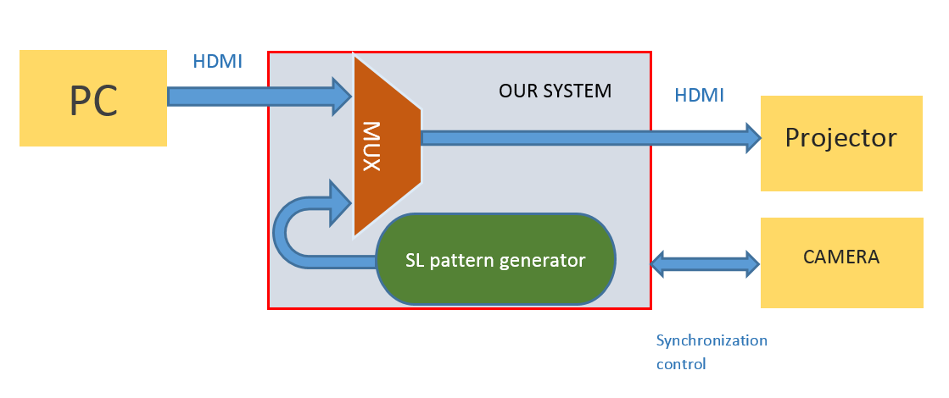
System diagram

Slide 6
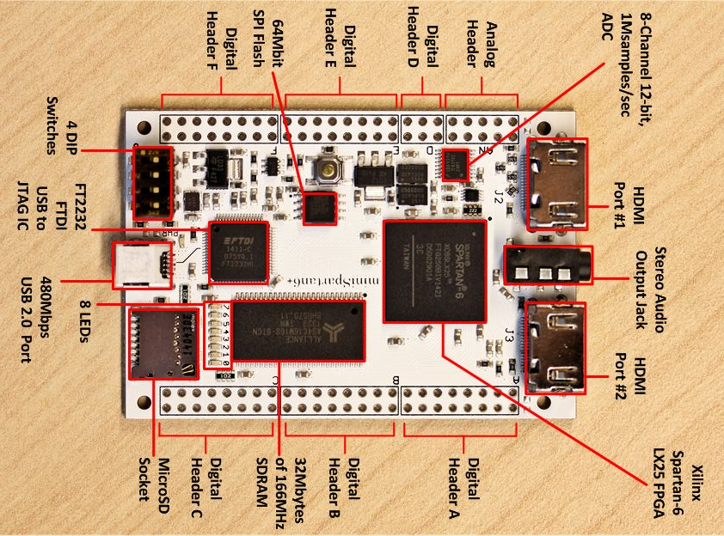
MiniSpartan6+ equipped with two on board HDMI ports

Slide 7
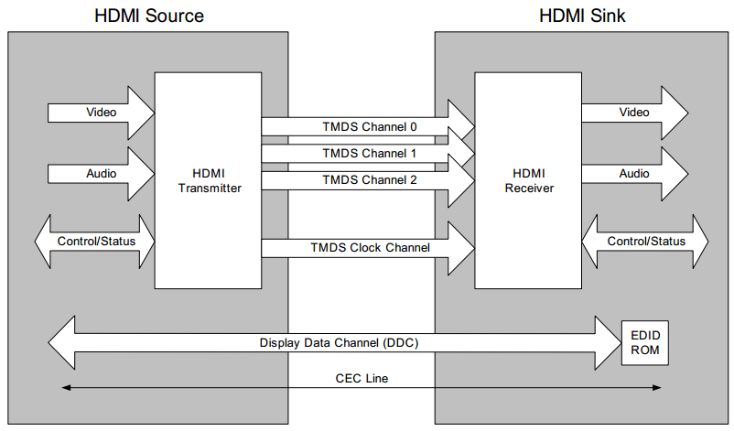
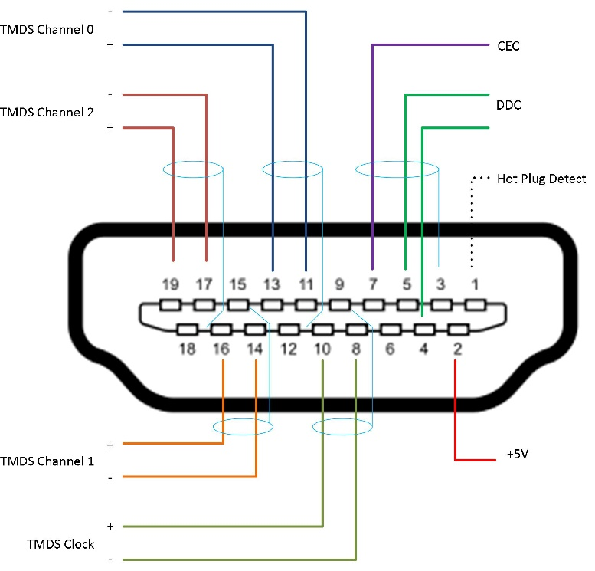
HDMI basics --- serial transmission
Notes:
CEC line is something related to end users’ remote control settings, we don’t use it in this project

Slide 8
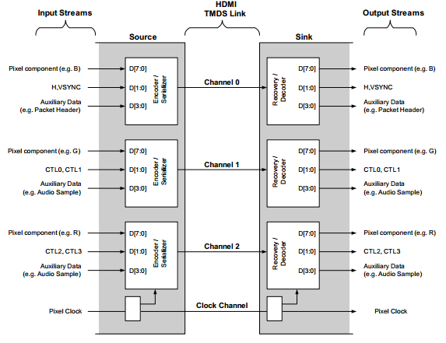
HDMI --- 3 data channels
Channel 0 --- Blue pixel data + control signals (H.SYNC, V.SYNC, etc.)
Channel 1 --- Green pixel data + audio data + control signals(CTL0, CTL1)
Channel 2 --- Red pixel data + audio data + control signals (CTL2, CTL3)

Slide 9
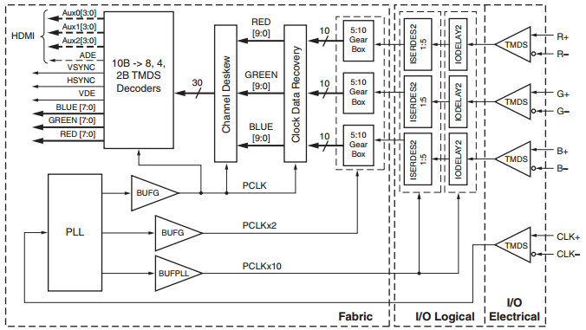
HDMI receiver
Hardware block diagram

Slide 10
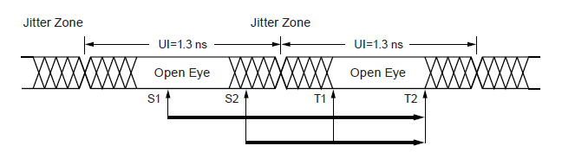
Clock data recovery & Channel deskew
HDMI specification allows some uncertain amount of delay among the pixel clock and each data channel
Clock Data Recovery: adjust the phase of pixel clock or serial data stream in each channel to make sure the rising edge of pixel clock falls in the open eye of serial data stream
Channel Deskew: synchronize decoded parallel output of 3 data channels

Slide 11
Problem we ran into
The system did not work consistently and reliably across different HDMI sources
different machines: desktop, laptop, embedded system with HDMI output
different OS: Window 7, Windows 10, Ubuntu
Solution: implement DDC channel to let the source identify what display system it is connected to

Slide 12
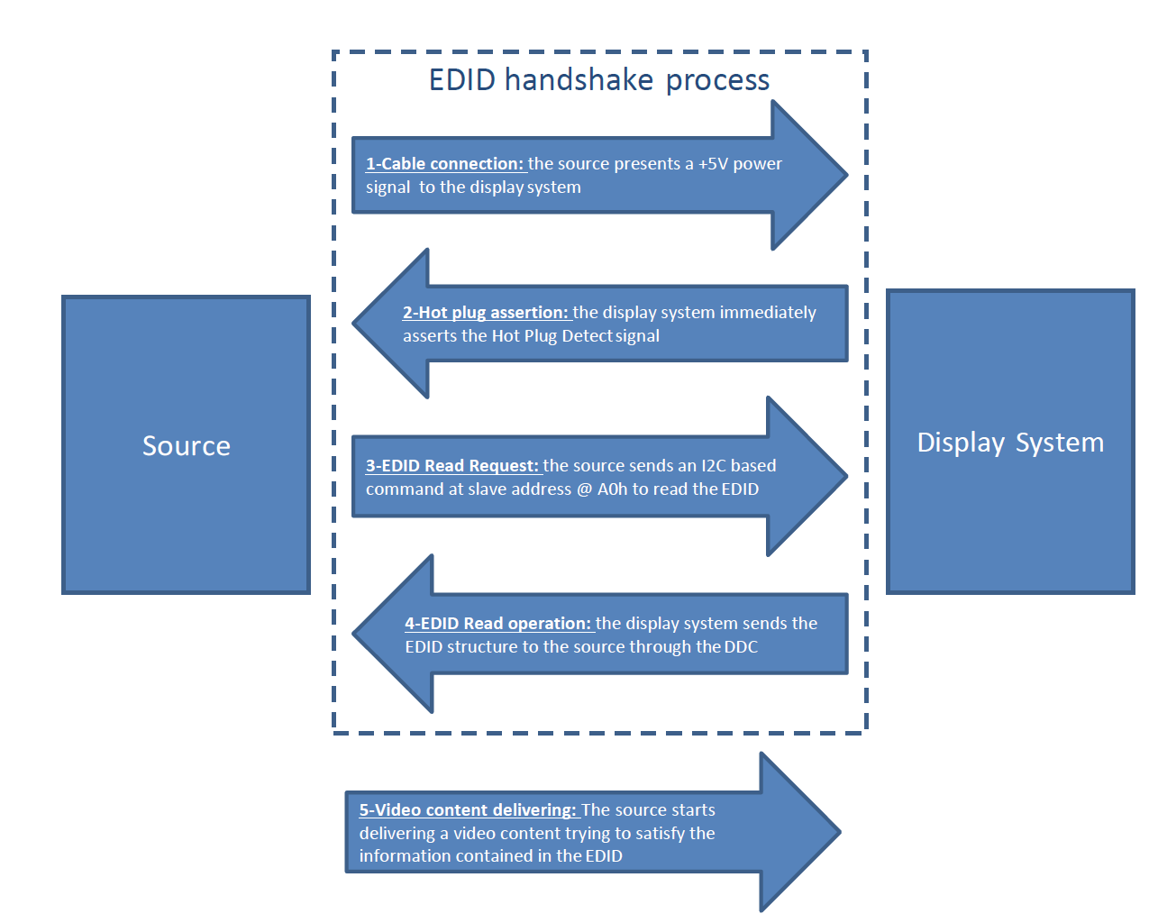
DDC channel & EDID
DDC: Display Data Channel
EDID: Extended Display Identification Data, 128-byte data block that includes information like manufactured year and month, manufacturer’s name, product’s serial number, screen size, supported resolutions and refresh rates etc.

Slide 13
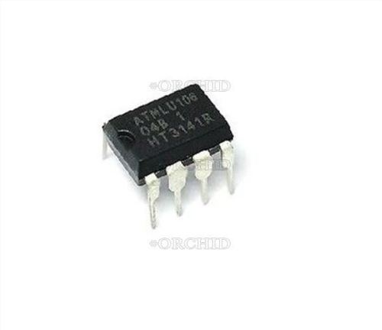
Electrically Erasable Programmable Read-Only Memory(EEPROM)
Usually, a monitor or projector uses an internal EEPROM or PROM chip to store its unique EDID

Slide 14
EDID sender
In our system, the HDMI source connects directly to the board, instead of a standard monitor or project
We have to implement a module that does the EEPROM’s job
I2C slave controller that sends 128 bytes EDID data to HDMI sources

Slide 15
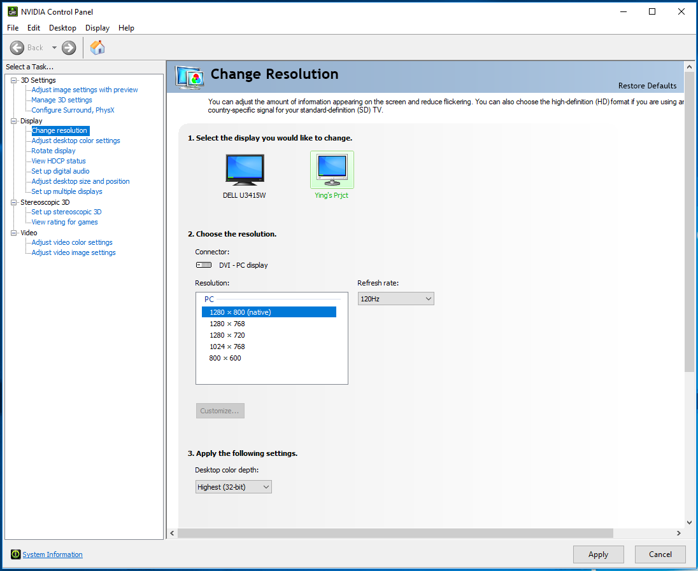
An example of customized EDID
We edit the EDID data, so the HDMI sources only output videos of certain resolutions and refresh rates

Slide 16
The limitations
Screen Mode | Pixel Rate (MHz) | Serial Data Rate (Mb/s) | Color Dep
640x480 @ 60 Hz | 25 | 250 | 24b
720x480 @ 60Hz | 27 | 270 | 24b
800x600 @ 60 Hz | 40 | 400 | 24b
1024x768 @ 60 Hz | 65 | 650 | 24b
1280x800 @ 60 Hz | 71 | 710 | 24b
1280x720 @ 60 Hz (720p) | 74.25 | 742.5 | 24b
1920x1080 interlaced @ 60 Hz (1080i) | 74.25 | 742.5 | 24b
The highest resolution we can work on is limited by the highest clock frequency the board can provide, higher resolution needs a higher-end FPGA board
The highest resolution we have tested to be working is 1080i@60Hz
Notes:
The maximum working clock frequency of Spartan6 FPGA limits the highest resolution the system supports.

Slide 17
The switch between two display sources
Structured light generator shares the same H.Sync and V.Sync from the PC
The switch between two sources is without any noticeable delay

Slide 18
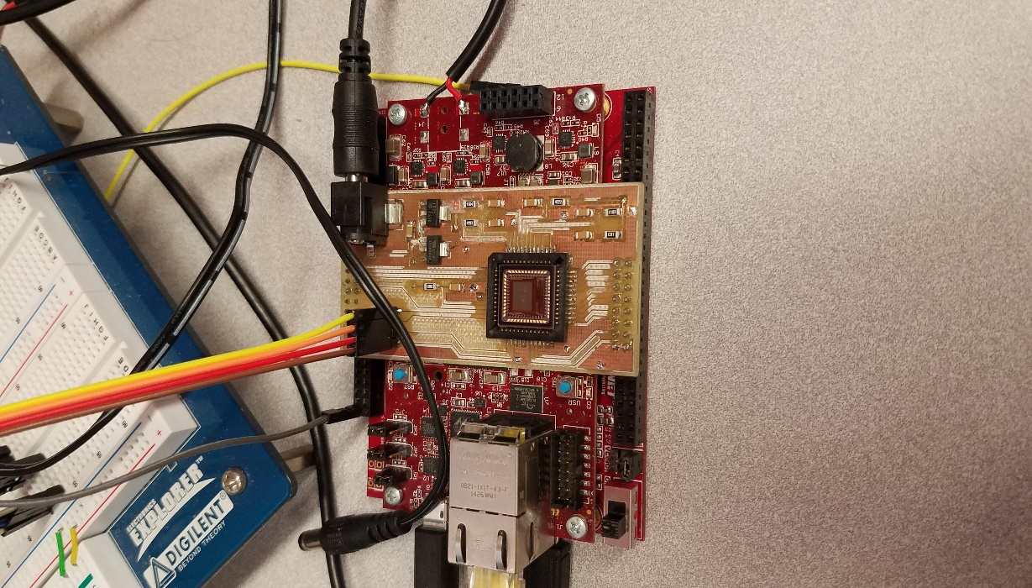
Machine vison camera for CASSI
The LUPA-300 camera system was mostly completed by the end of summer 2017
The HDMI project started after that
LUPA-300 camera

Slide 19
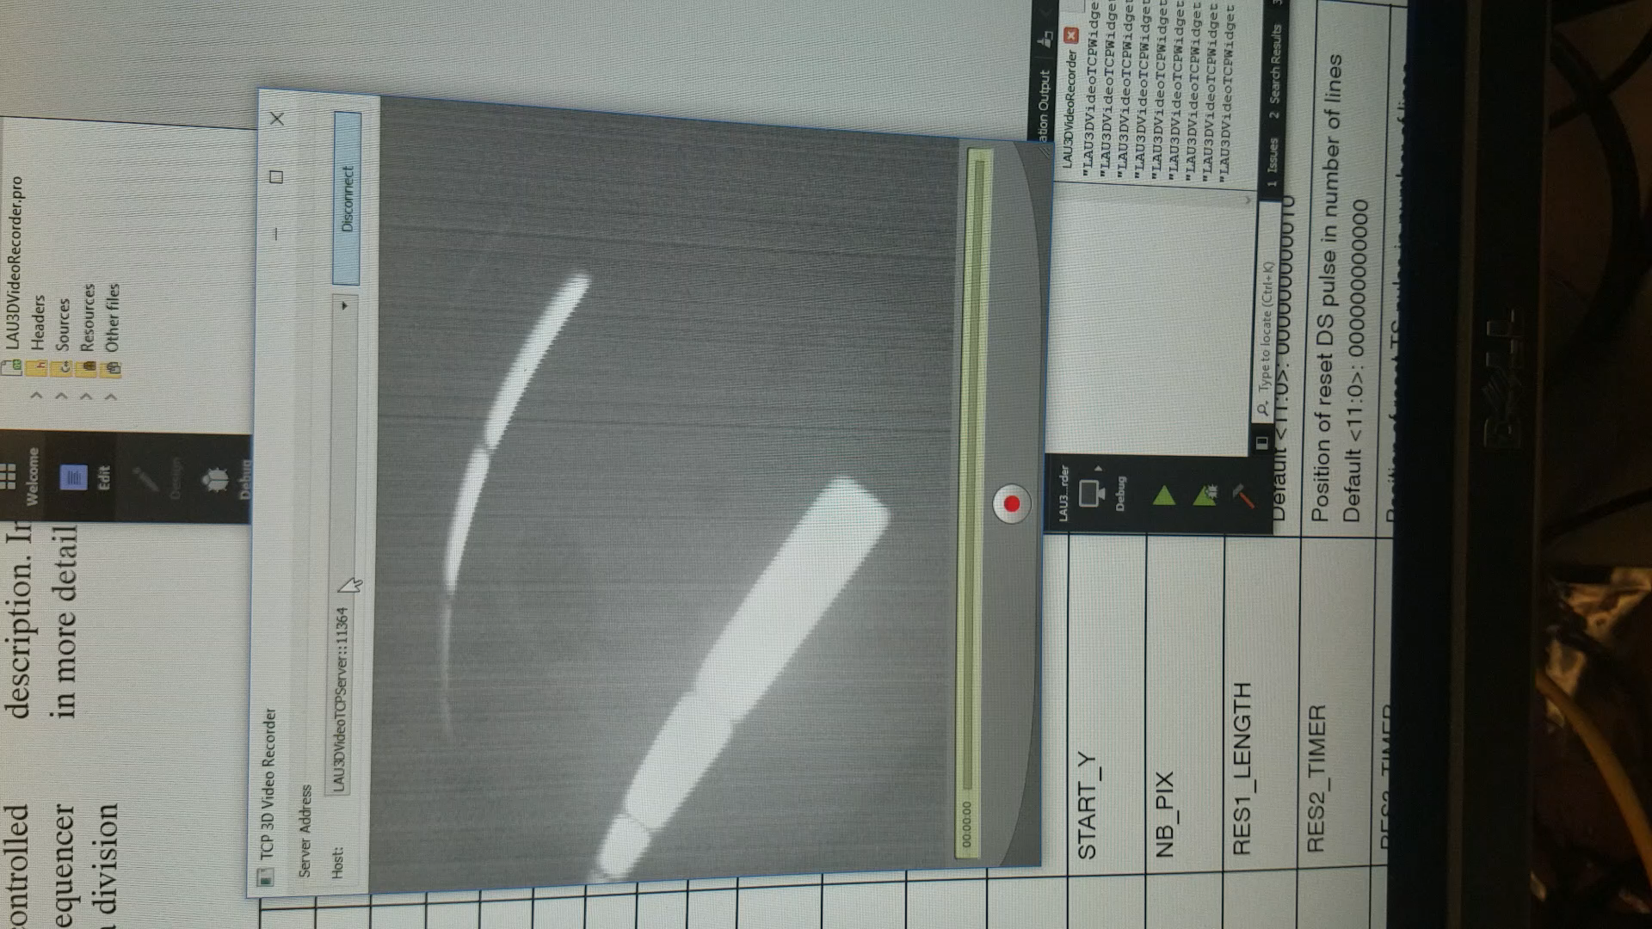
Non-destructive readout sample video
The video shows the roof of our lab, the sensor’s pixels value don’t reset until 4 frames have been taken, so except the first frame after pixel reset, all the following frames are over exposed, they appear to be very bright (fixed pattern noise has not been cancelled in this video)

Slide 20
END
2018 Spring

